Slide 1
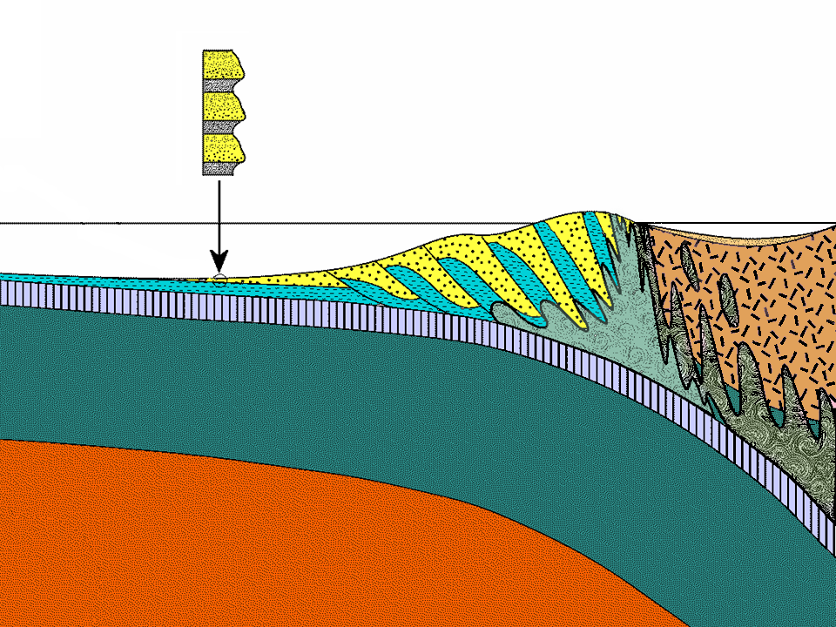
Turbidite
Mélange
Serpentinite
Pelagic
Sediments
Increasing metamorphism
Basalt
Gabbro
Notes:
On Catalina, all accretionary wedge rocks were metamorphosed to some degree as subduction carried to them to progressively greater depths. We will now examine how the various wedge rocks responded to metamorphism.

Slide 2
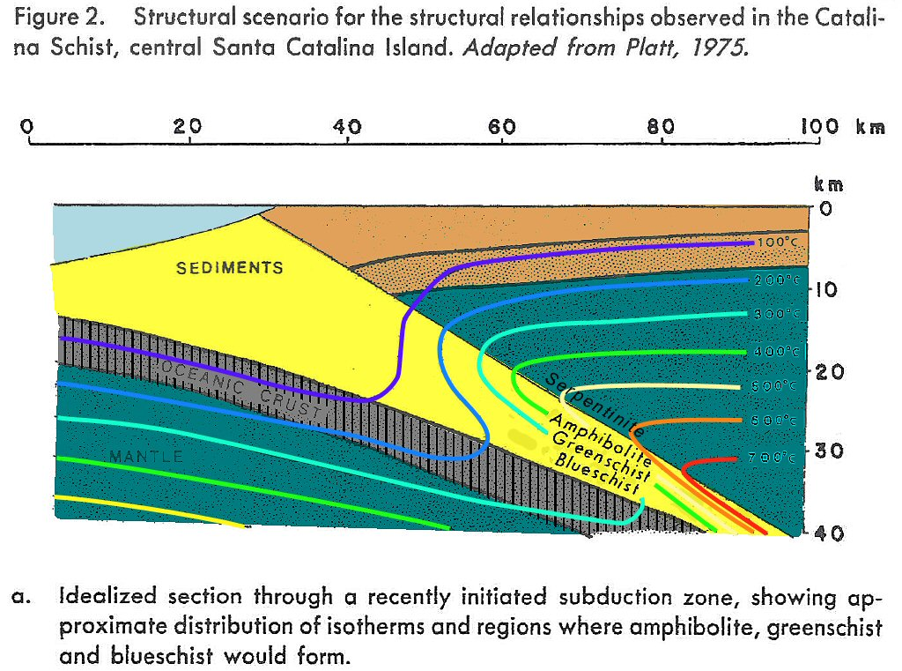
Notes:
In an accretionary wedge, sediments stay relatively cool next to the subducted oceanic crust but pressures increase greatly as subduction carries them to progressively greater depths. Thus the temperature gradient above subducted oceanic crust is inverted, …

Slide 3
Metamorphic Facies and Paths of Metamorphism
Notes:
… and changes in pressure and temperate follow path 5 in the metamorphic facies diagram. Metamorphic facies are environments defined by specific ranges in temperature and pressure. Facies names are based on the type of rock formed from the metamorphism of a mafic parent (e.g. basalt, basaltic sand, gabbro).

Slide 4
Wedgie composition
Turbidite (mostly greywacke)
Mafics (basalt, gabbro, basaltic debris)
Pelagics (mostly chert)
Mantle (serpentinite)
Notes:
So let’s take each of the 4 wedge components and see how subduction metamorphism changes them.

Slide 5
Assumption
Turbidite
Mafics
Pelagics
Mantle
Reality
Turbidite
Mafics
Pelagics
Mantle
Mg Na
+2
+
Mg
+2
No metasomatism
(ions stay put)
Metasomatism
Notes:
In this discussion we will assume that ions do not migrate from one material to another during metamorphism. However, in the fluid-rich environment of a mélange, soluble ions like Mg and Na are so mobile that virtually all parent materials become infused to some degree with these two ions.

Slide 6
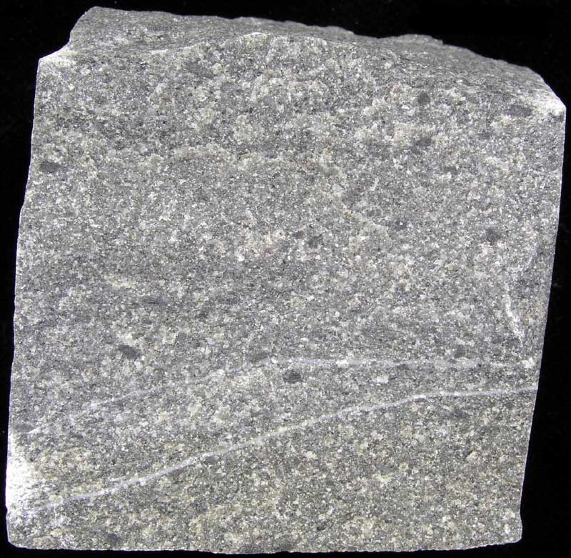
Turbidite
Shale Greywacke
Notes:
Although only minor amounts of shale were accreted to the wedge, shale is the far more susceptible to metamorphism than greywacke.

Slide 7
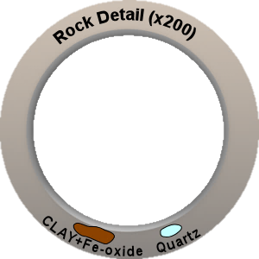
Shale
Notes:
That’s because shale contains clay. Clay is a product of weathering and is therefore stable under surface conditions. If subjected to higher temperatures and pressures it becomes unstable and will metamorphose into more stable minerals.

Slide 8
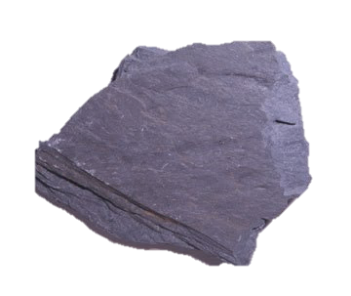
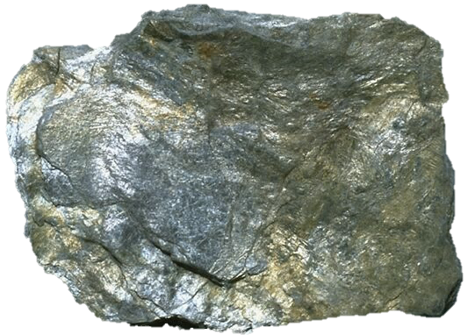
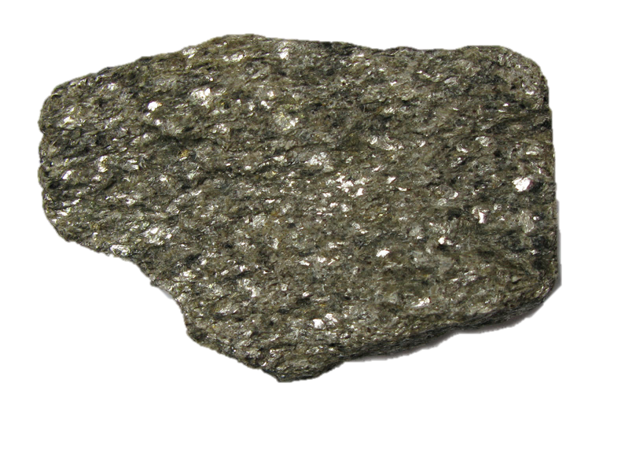
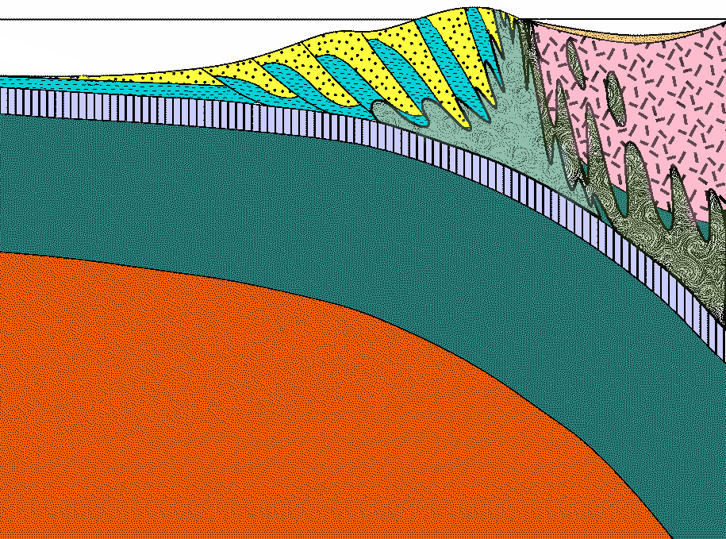
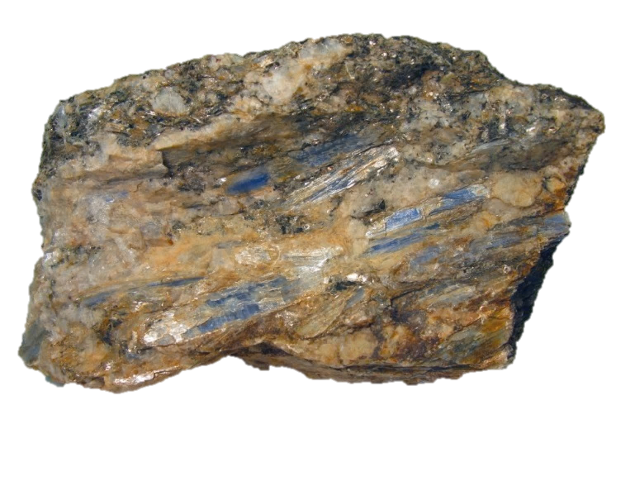
Shale
Slate
Typical subduction path
Phyllite
Schist
Gneiss
Notes:
As shale is carried to greater depths by subduction it can potentially transform into a wide variety of metamorphic rock types.

Slide 9
Shale
Slate
Typical subduction path
None are common in Catalina!
Phyllite
Schist
Gneiss
Locally present
Notes:
Although phyllite and schist are locally present, none of these rocks are particularly common on Catalina.

Slide 10
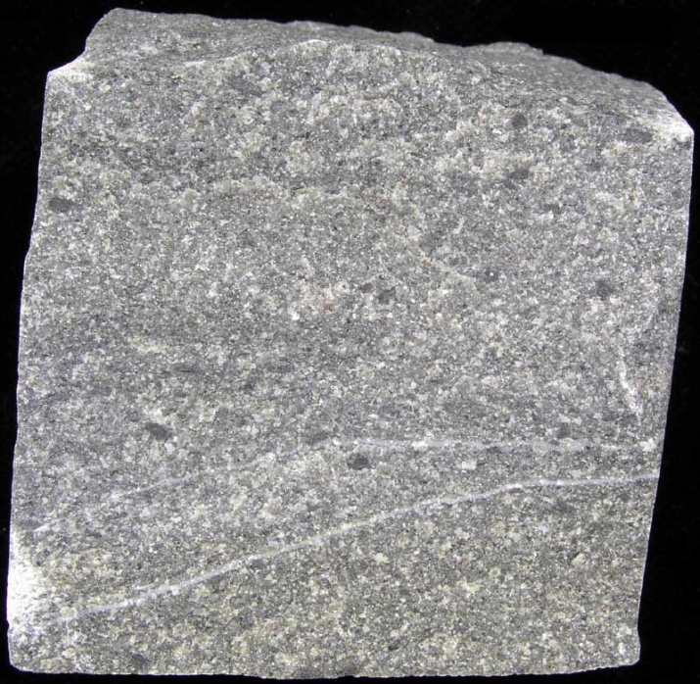
greywacke
Notes:
Now let’s see what happens to the for more common rock greywacke upon metamorphism. Since greywacke has far less clay than shale and contains more metamorphism-resistant minerals like quartz and feldspar, …

Slide 11

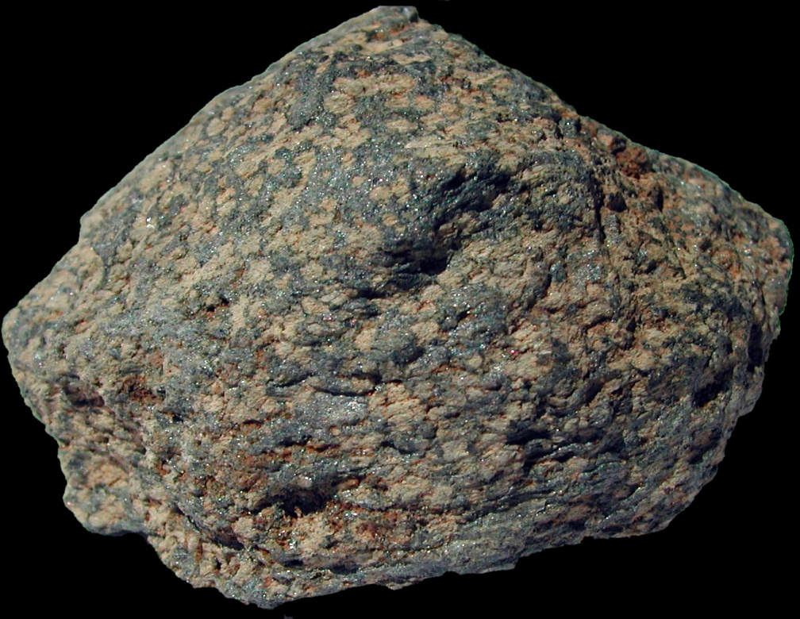
greywacke
meta-greywacke
Notes:
… the changes in greywacke due to metamorphism are relatively minor. Metamorphism of greywacke may change its mineralogy, but only minor textural changes (such as increased grain size) will be evident. The prefix “meta” is applied to such rocks when much of the character of the original parent rock remains after metamorphism.

Slide 12
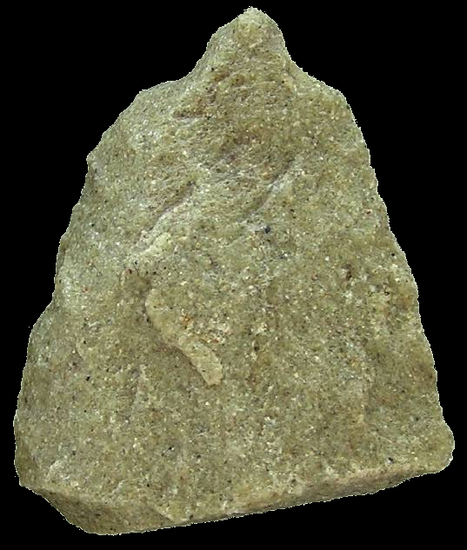
greywacke
meta-greywacke
Quartzite?
Notes:
Particularly quartz-rich / clay-poor greywacke may metamorphose into the completely non-foliated (no mineral alignment) rock quartzite. Because the changes in greywacke upon metamorphism are relatively minor, greywacke is a poor indicator of metamorphic facies.

Slide 13
Mafic Components
Oceanic crust
Seamounts
Forearc basement
forearc thrust
Notes:
Now let’s see what happens to the wedge’s mafic components.

Slide 14
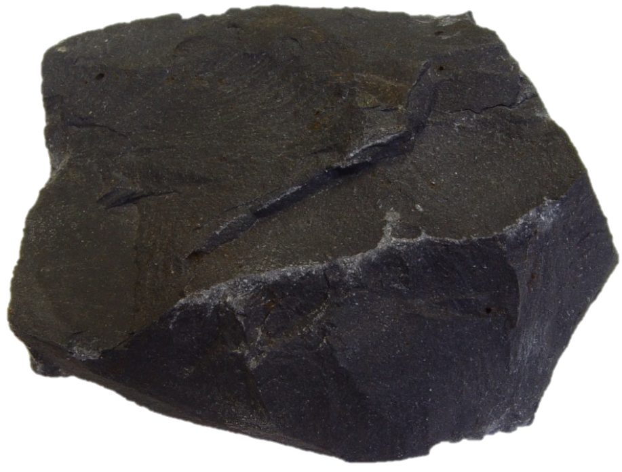
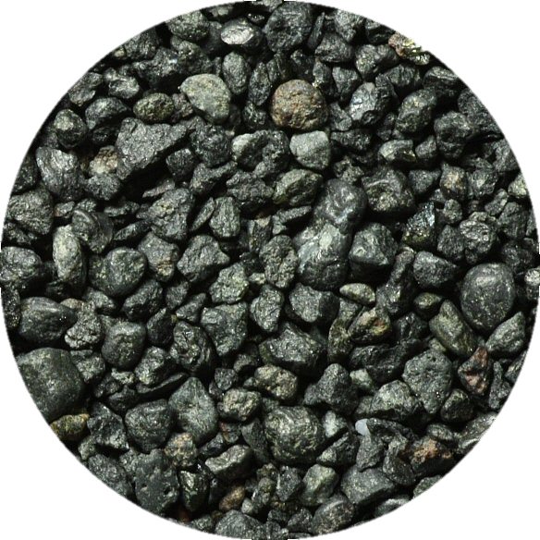
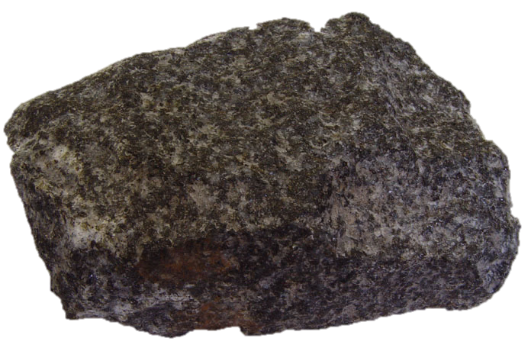
Mafics
Basalt
Gabbro
Basaltic sand and conglomerate
Notes:
Since they have exactly the same composition, all mafic materials will follow the same set of changes during metamorphism in an accretionary wedge.

Slide 15

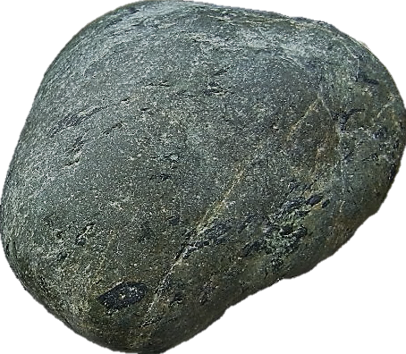
Basalt
Typical subduction path.
Metabasalt
Notes:
At low temperature and pressure subduction typically causes only minor changes to mafic rocks because subduction is generally too rapid for metamorphic reactions to reach equilibrium. Thus, basalt would transform into the rock metabasalt – a rock consisting of only a small percentage of metamorphic minerals (prehnite, pumpellyite and chlorite) and which retains much of the primary texture of basalt.

Slide 16
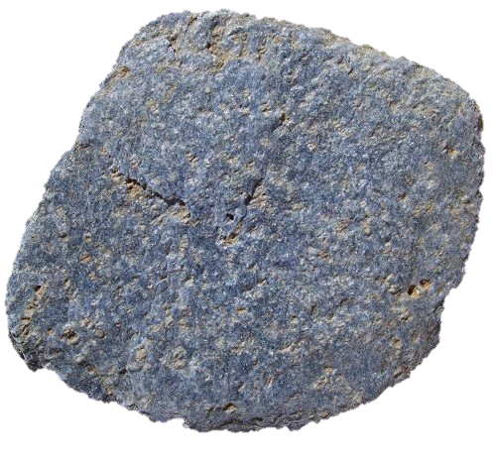
Basalt
Typical subduction path.
Metabasalt
Blueschist
Notes:
Metamorphic reactions accelerate as mafic rocks are subducted to greater depths and the distinctive rock blueschist forms.

Slide 17
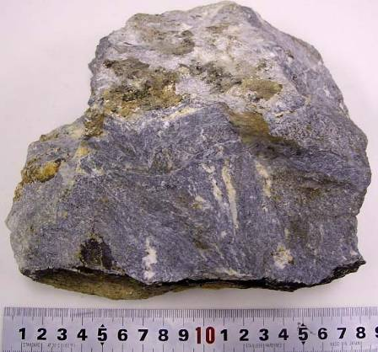
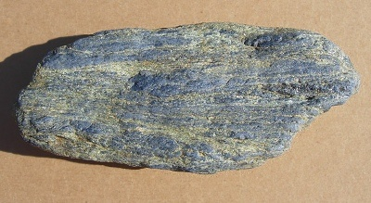
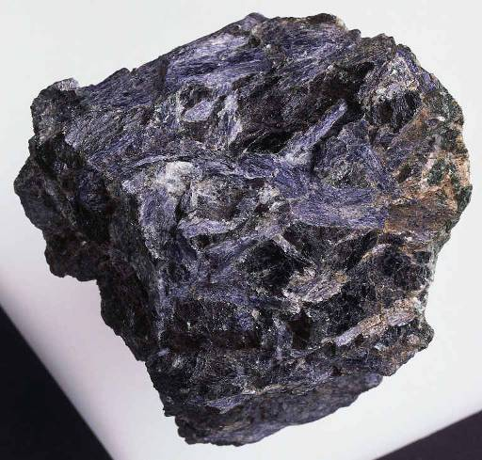
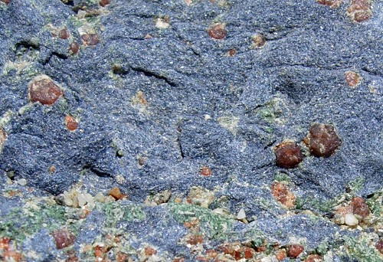
Glaucophane
Notes:
High pressure-low temperature metamorphism causes low-grade metamorphic minerals like prehnite and pumpellyite (in metabasalt) to dissolve. Their ions recrystallize into the distinctively blue mineral glaucophane plus lesser amounts of white to grey-blue lawsonite and pistachio-green epidote. Since glaucophane is an elongated mineral, differential stress will cause it to align parallel to the subduction zone, producing a schistose texture. The name blueschist combines the characteristic blue color of glaucophane with its commonly schistose texture.

Slide 18
Assumption
Turbidite
Mafics blueschist
Pelagics
Mantle
Reality
Turbidite blueschist
Mafics blueschist
Pelagics blueschist
Mantle
Mg Na
+2
+
Mg
+2
No metasomatism
(ions stay put)
Metasomatism
(ions migrate)
Notes:
Without metasomatism, one would assume that only mafic parents could be metamorphosed into blueschist. With metasomatism, almost all parent materials can develop the characteristic blueschist assemblage of glaucophane-lawsonite.

Slide 19
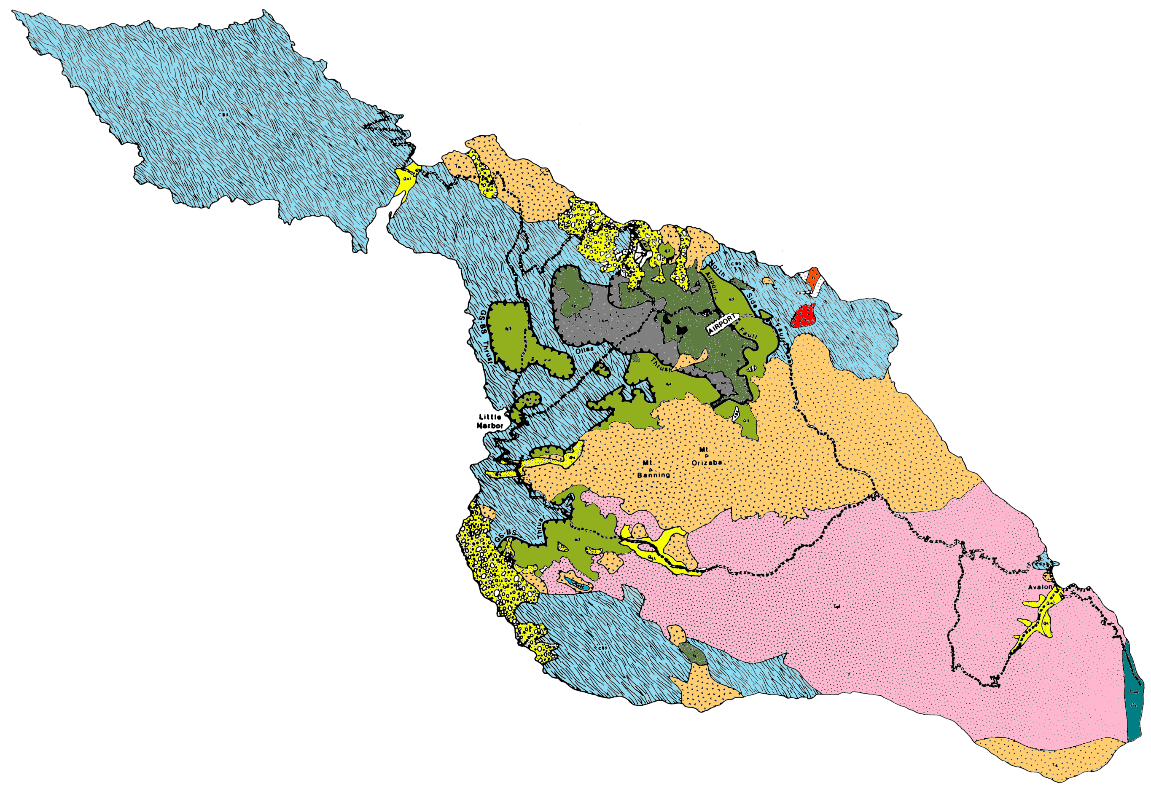
Blueschist found at lower elevations
Notes:
Although blueschist facies metamorphic rocks are the most widespread of all rock types on the island, they do not occur in the southeast or higher elevations of the island. Take note of the elevation restriction as it will be important in working out the metamorphic structure of Catalina.

Slide 20
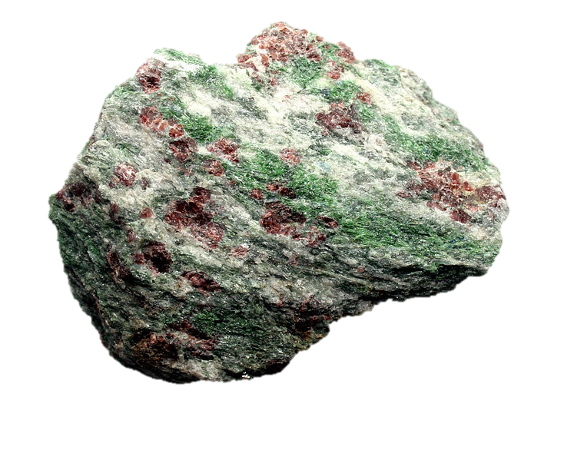
Basalt
Typical subduction path.
Metabasalt
Blueschist
Eclogite
Notes:
Unlike sedimentary rocks which are mostly scraped-off by subduction, basalt and gabbro can be carried to extreme depths by subduction. Under such conditions all hydrous minerals (mostly amphibole in this case) transform into anhydrous minerals such as garnet, pyroxene and kyanite. The resultant rock is the rare and beautiful rock eclogite.

Slide 21
Eclogite is sporadically dispersed in mélange
Notes:
Blocks of eclogite are sporadically distributed in the mélange, but seem to be particularly common just north of the airport.

Slide 22
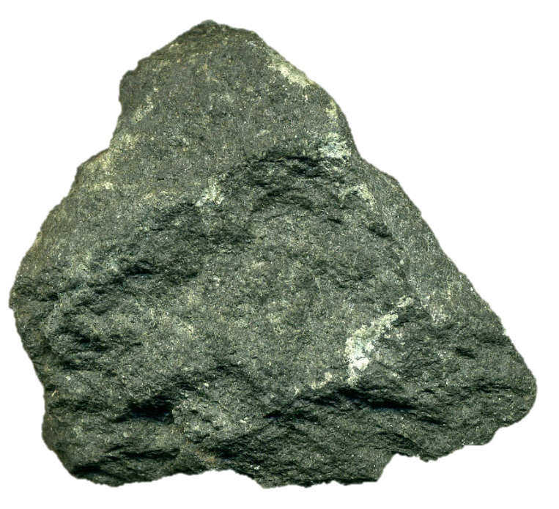
Greenstone
Typical subduction path.
Path of some Catalina rocks?
Notes:
Apparently some Catalina rocks followed a metamorphic path with slightly elevated temperatures. Instead of passing through blueschist metamorphism they were subjected to greenschist metamorphism. Differential stress may not be high enough during the initial phases of greenschist facies metamorphism to align minerals to produce a schistose texture, so the first rock formed from the progressive metamorphism of mafic rock along this path is often the unfoliated rock greenstone (named for the green metamorphic minerals like chlorite, epidote and actinolite that it typically contains).

Slide 23
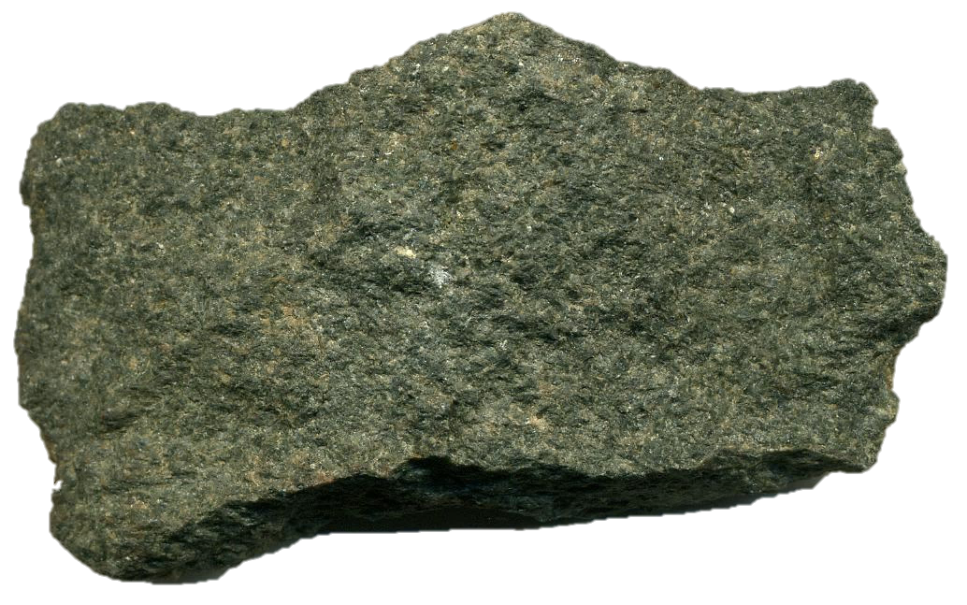
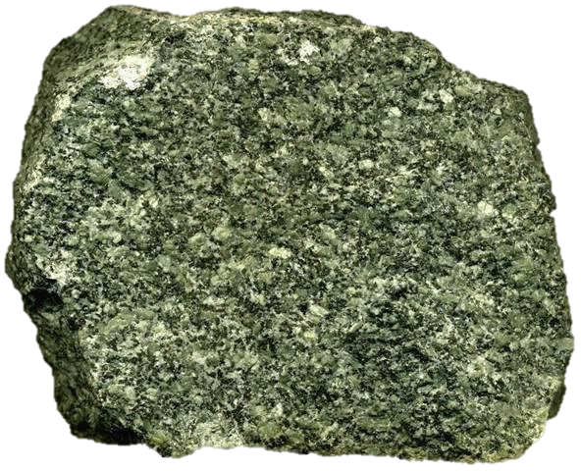
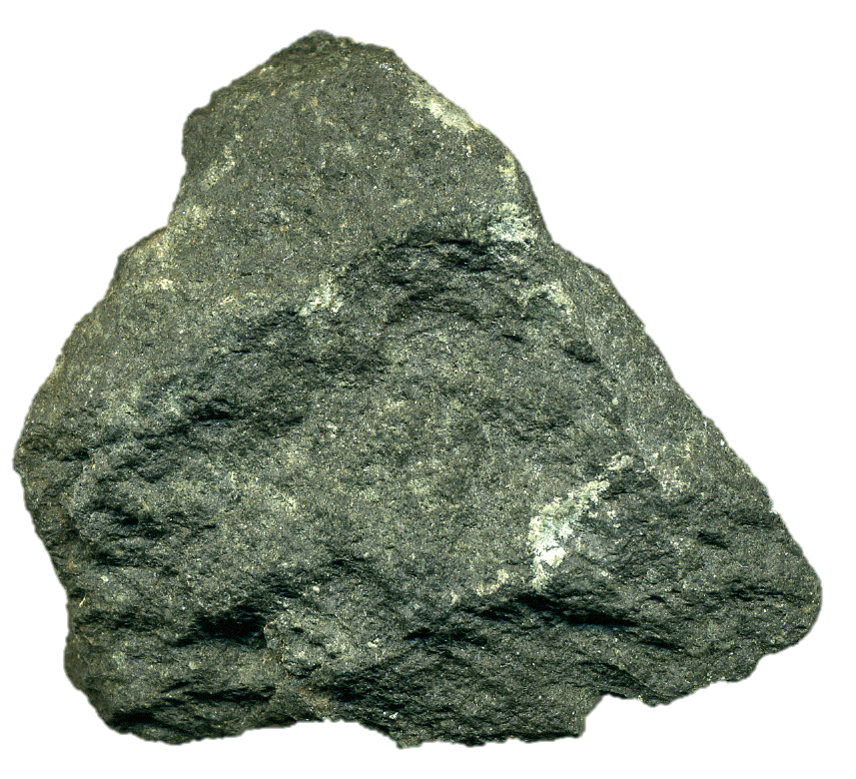
Typical subduction path.
Path of some Catalina rocks?
Greenstone
Notes:
Greenstone can be a very confusing rock, especially on Catalina Island. Strictly speaking, greenstone forms under greenschist facies metamorphism. A similar rock could theoretically form under blueschist facies conditions but rarely does, because subduction is generally too rapid for rocks to reach equilibrium at such low temperature and pressure. Nevertheless, greenstone is common in subduction zones – not because it forms there, but because greenschist facies metamorphism is common at divergent plate boundaries were ocean crust forms. Thus greenstone is more commonly brought to the subduction zone, rather than made there.
Adding to these complexities is that some Catalina rocks may have followed a significantly higher temperature path relative to typical subduction metamorphism. Thus Catalina greenstones may indeed have encountered greenschist facies metamorphism in the subduction zone.
If that’s not confusing enough for you, greenstone only becomes the rock greenschist when there is sufficient differential stress (common in subduction zones). Also note that although some greenstone can become greenschist, only greenschist with a mafic parent can be greenstone. Got it? E Z P Z !!!!!!

Slide 24
Greenschist occurs at medium elevations
Notes:
Greenschist facies metamorphic rocks occur in discontinuous outcrops towards the central part of the island and tend to occur at medium elevations.

Slide 25
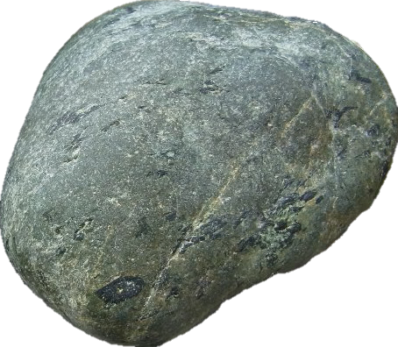
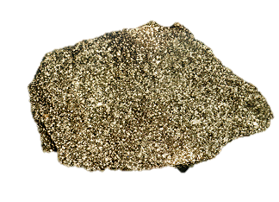
Typical subduction path.
Path of some Catalina rocks?
Amphibolite
Notes:
Under higher temperatures and pressures the green minerals in greenstone metamorphose into black minerals like hornblende and the rock becomes amphibolite.

Slide 26
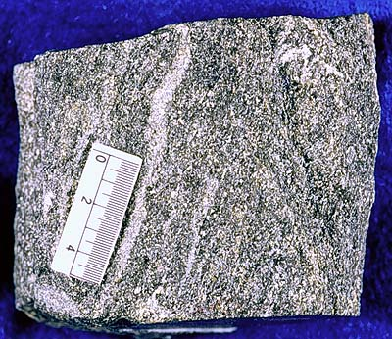
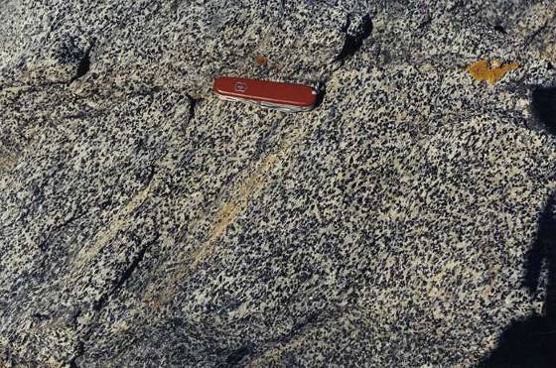
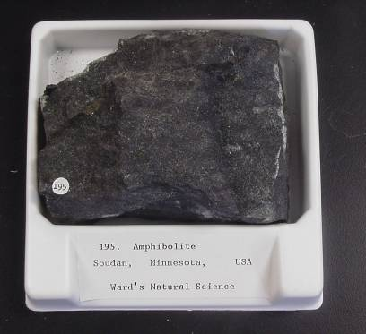
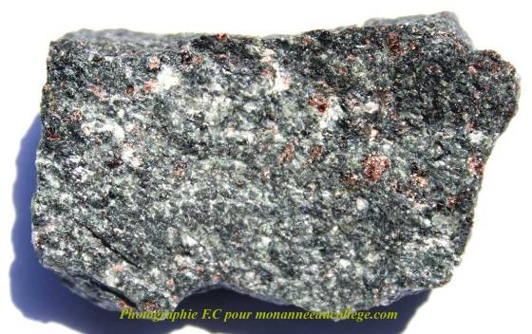
Amphibolite
Mélange
Notes:
Amphibolite has a characteristic “salt and pepper” appearance and is only weakly foliated.

Slide 27
Amphibolite found at higher elevations
Notes:
Amphibolite facies metamorphic rocks are generally found at higher elevations than greenschist facies rocks.

Slide 28
Basalt
Greenstone
Typical subduction path.
Path of some Catalina rocks?
Metabasalt
Amphibolite
Blueschist
Eclogite
Notes:
Under the truly hellish temperature and pressure towards the bottom of a subduction zone both paths converge. Only fully dehydrated minerals survive like pyroxene, garnet and kyanite. The resultant rock is eclogite.

Slide 29
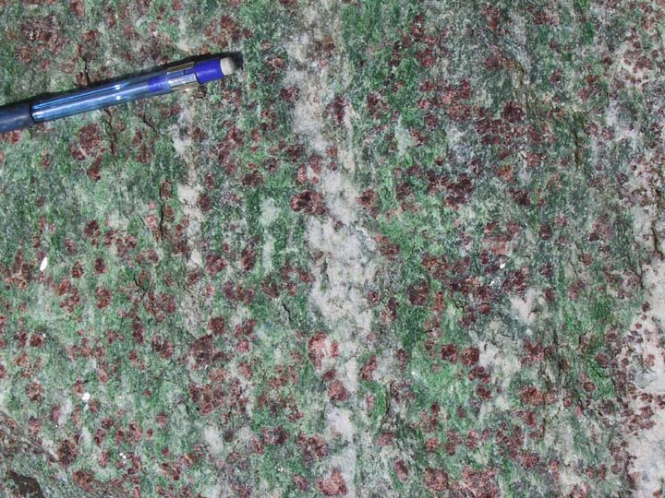
Eclogite
Notes:
Eclogite is a rare, beautiful and geologically significant rock, but is relatively common on Catalina.

Slide 30
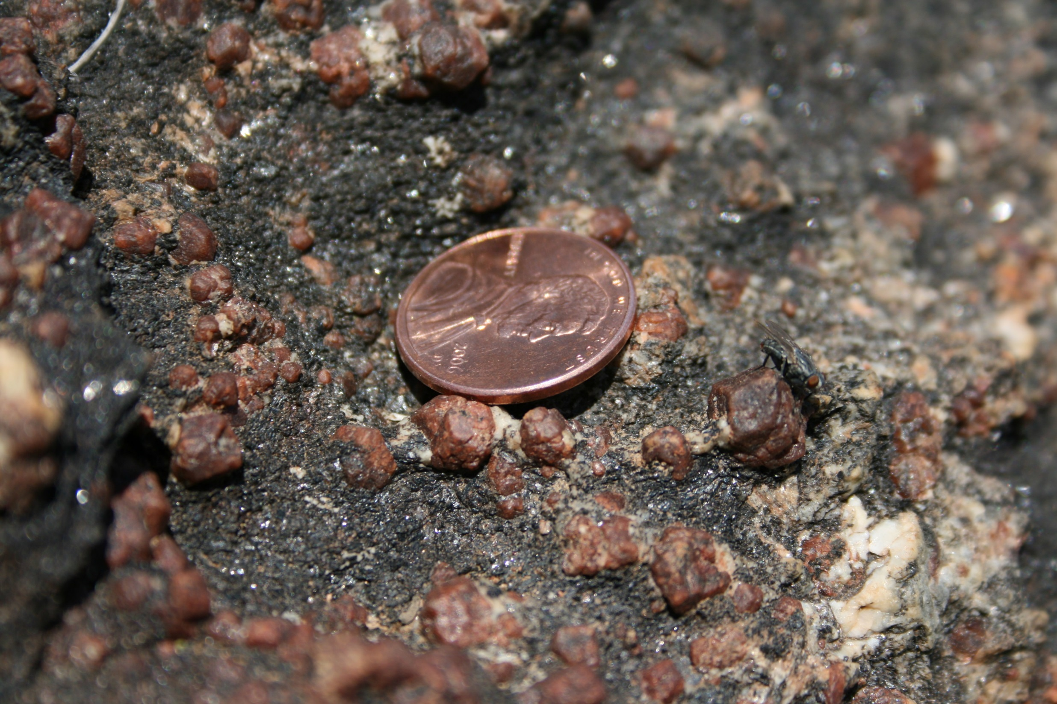
Catalina eclogite
Notes:
All eclogite that I have seen on Catalina Island lacks the distinctive green pyroxene “omphacite”. Perhaps retrograde metamorphism (common in metamorphic rocks exhumed from extreme depths) converted the green omphacite into black hornblende.

Slide 31
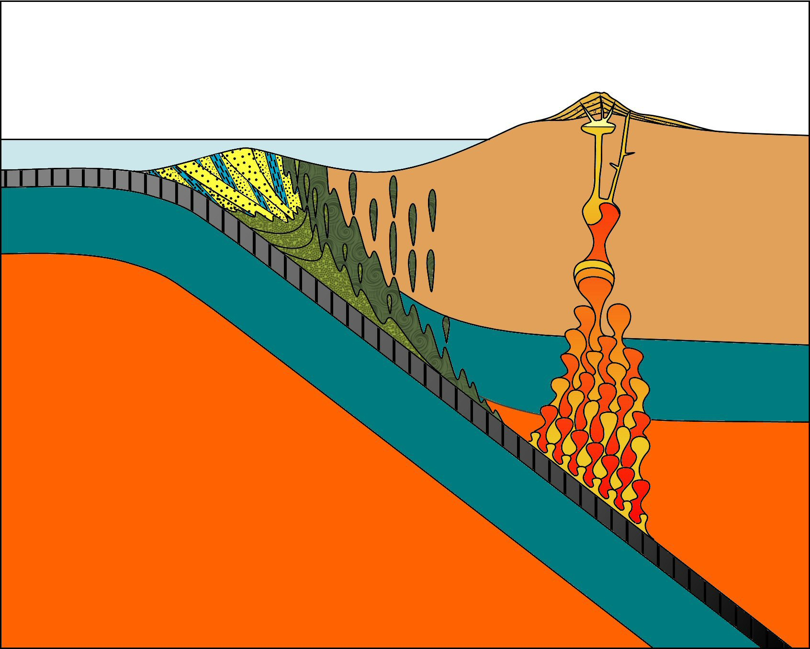


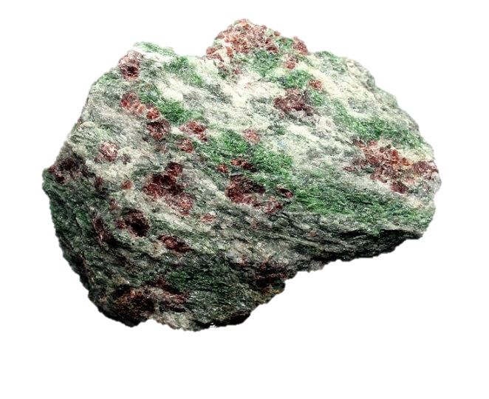
Dehydration of Ocean Crust
basalt
H₂O
Most water
greenstone
or metabasalt
H₂O
amphibolite
or blueschist
H₂O
Wet melting
eclogite
Least water
Notes:
Eclogite not only represents the highest degree of metamorphism for basalt in a subduction zone, but also represents its complete dehydration as deeper subduction causes progressively more water to migrate into the lower wedge and upper mantle. That eclogite is exposed on Catalina bears witness to the tremendous amount of uplift that has taken place there.

Slide 32
Turbidite
Pelagic
Sediments
Notes:
OK, now let’s see what happens to pelagic sediments carried into the accretionary wedge.

Slide 33
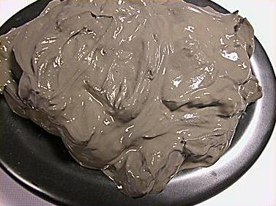
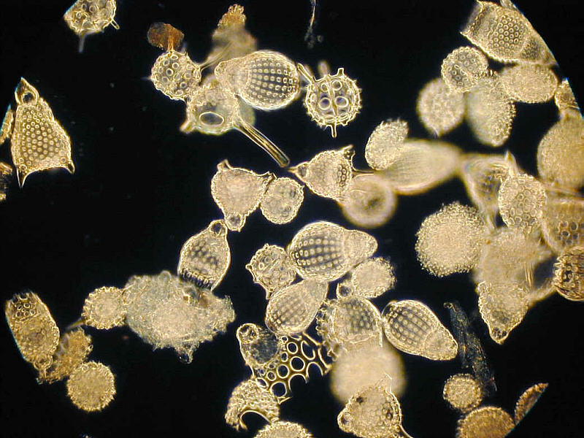
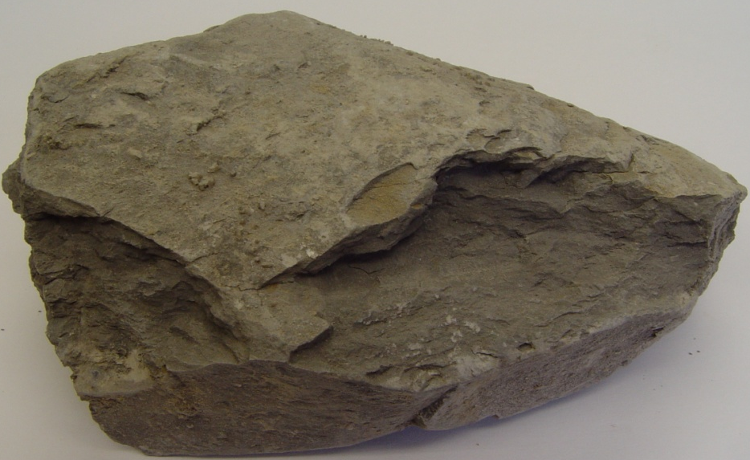
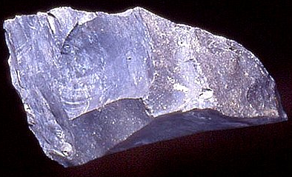
Pelagic Sediment
Clay
Siliceous ooze
Shale
Chert
Notes:
Recall that the pelagic sediment brought to the wedge was comprised mainly of siliceous ooze which hardens into chert and minor amounts of pelagic clay which hardens into shale.

Slide 34

Shale
Slate
Phyllite
Schist
increasing metamorphism
Gneiss
Notes:
Shale derived from pelagic clay will metamorphose into pretty much the same suite of rocks that turbidite-derived shale did. None of these are particularly common on Catalina, but because of metasomatism shale-derived schist (pelitic schist) can become blueschist.

Slide 35
Pelagic Sediment
Clay
Siliceous ooze
Shale
Chert
Notes:
Chert on the other hand, since it is made almost entirely of silica, which is very stable during metamorphism, …

Slide 36
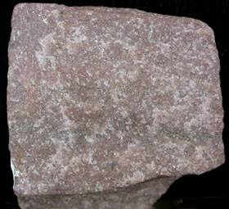
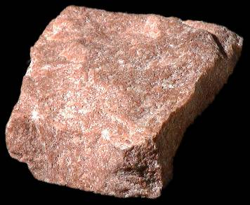
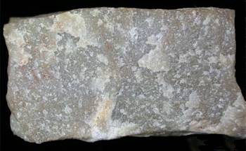
Chert
Quartzite
Quartzite
Notes:
… will recrystallize only slightly to form quartzite. Like greywacke, the relatively minor changes that occur during the metamorphism of chert make it a poor indicator of metamorphic facies. Because of metasomatism, however, even quartzite can contain glauconite and lawsonite.

Slide 37
Turbidite
Serpentinite
Pelagic
Sediments
Basalt
Gabbro
mantle
(Peridotite)
mantle
(Peridotite)
Notes:
As for metamorphism of the upper mantle …

Slide 38
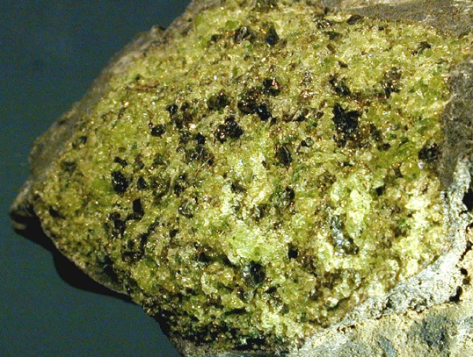
Mantle
Peridotite
Notes:
… you already know what happens to peridotite that becomes part of an accretionary wedge …

Slide 39
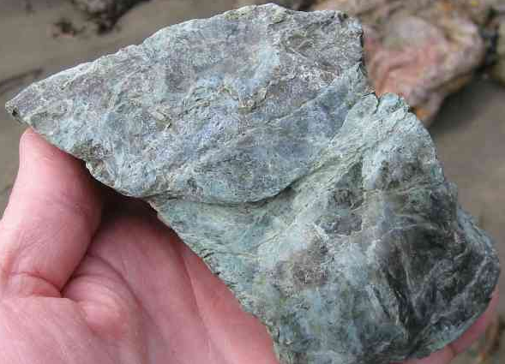
Mantle
Peridotite
Serpentinite
Notes:
… that’s right, it turns into serpentinite.

Slide 40
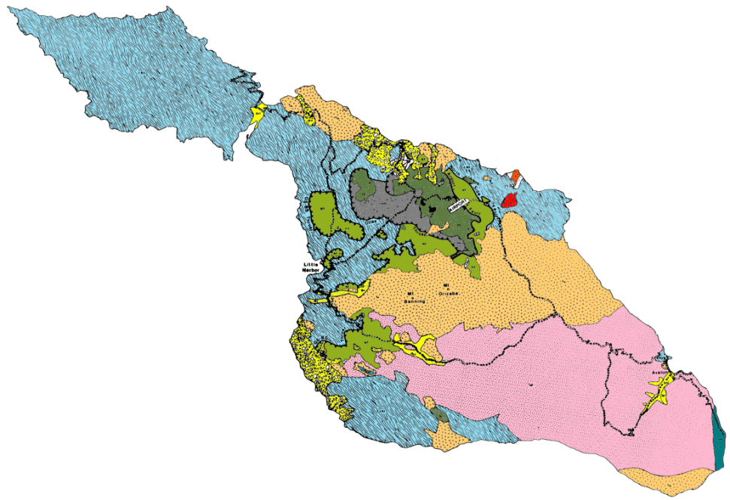
Mantle
Peridotite
Serpentinite
Notes:
Serpentinite knockers are sporadically distributed on Catalina, but the most continuous outcrops of serpentinite occur at even higher elevations than the amphibolite because that region represents the mantle wedge above the accretionary wedge.

Slide 41
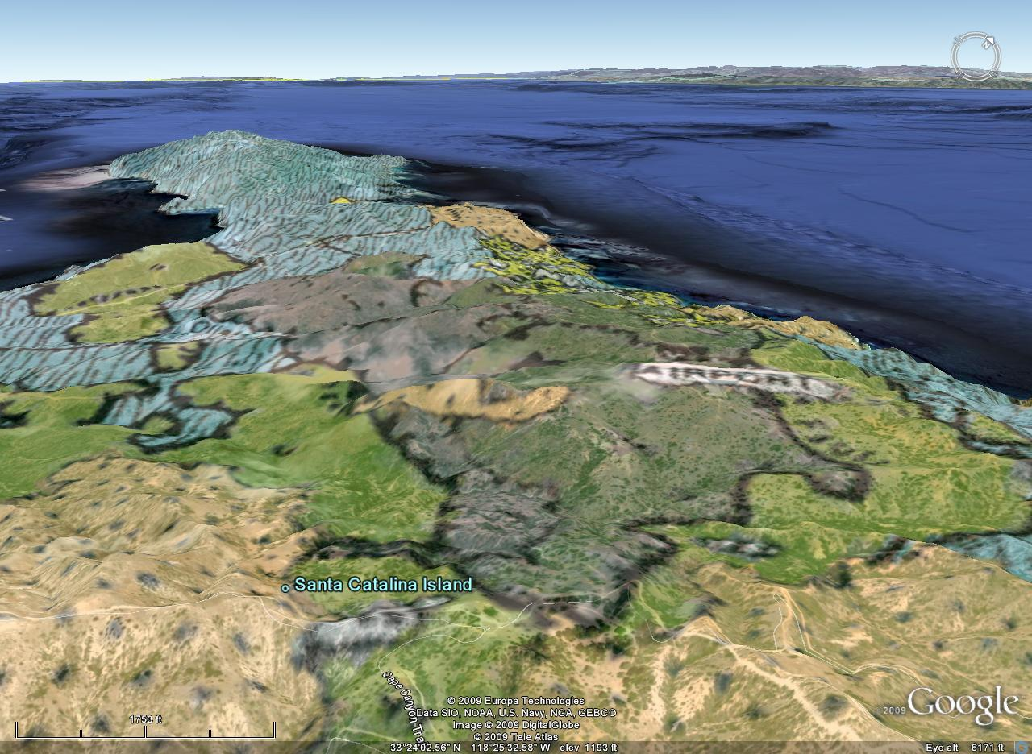
Serpentinite
Amphibolite
Blueschist
Greenschist
Notes:
From the right angle and with the geologic map overlay, one can actually see the structure of the Mesozoic subduction zone in the arrangement of rock types near Catalina’s airport. How’s that for cool?!! Ah but only if it were only so simple…..

Slide 42
Notes:
The inverted metamorphism interpretation, which was accepted for almost 30 years, implied that the parent rocks of the various metamorphic units should have roughly the same age since they would have all been subducted together.

Slide 43
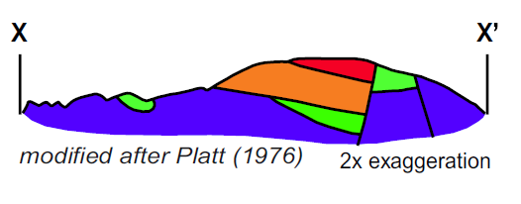
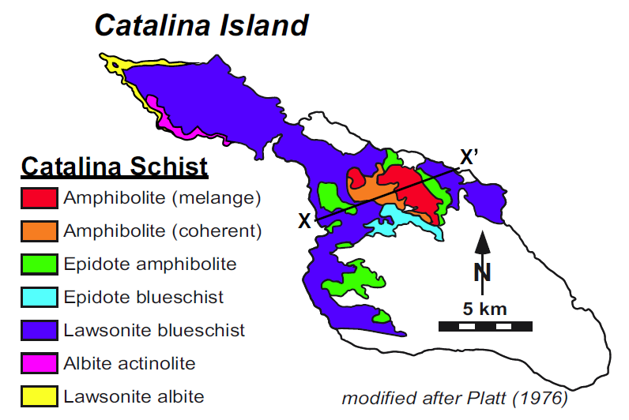
Diagrams from Grove et al, 2006
Notes:
But a more recent and thorough examination of Catalina’s metamorphic rocks …

Slide 44
120-115 Ma
100-95 Ma
Notes:
… revealed that the amphibolite grade parent rocks were subducted between 15-20my before those for blueschist grade metamorphic rocks.

Slide 45
HEAT
HEAT
Notes:
After such a long period of subduction a lot of heat from the upper plate rocks would have conducted into the relatively cool subducted oceanic crust beneath, thermal gradients would equilibrate and the inverted temperature profiles would be destroyed.

Slide 46
Notes:
Thus the original model only holds for a recently initiated subduction zone. By the time Catalina’s blueschist parent materials had been subducted, subduction had been active for at least 20my – time enough to eliminate the inverted temperature profiles.

Slide 47

Notes:
Combined with provenance ties linking the Catalina schist to the Peninsular Ranges Batholith, the age relationships suggested that the amphibolite grade rocks formed from early Cretaceous forearc basin sediments…

Slide 48

Notes:
… that were thrust under the western margin of the actively forming Peninsular Ranges Batholith where ample heat was available for amphibolite grade metamorphism.

Slide 49

Notes:
Further addition of magma to the western PRB brought plutons in close proximity with the amphibolites while continued compression thrust younger forearc basin sediments beneath them. Being slightly further from the batholith, these younger sediments were subjected to slightly lower temperature and metamorphic grade. The intense compression resulted in a significant amount of subduction erosion along the base of the North American Plate’s leading edge which brought younger blueschist grade metamorphic rocks ever closer to the older amphibolites.

Slide 50

Notes:
Eventually subduction erosion brought the blueschists in contact with the amphibolites – an event which coincided with the initiation of rapid convergence between the Farallon and North American plates and the flattening of the subduction angle. In this model massive devolatilization from the deeply underthrusted Catalina Schist led to extensive wet melting in the eastern PRB.

Slide 51

Notes:
Further underplating of trench-derived sediment carried large quantities of Catalina Schist-related rocks surprisingly far east of the PRB.

Slide 52

Notes:
One model suggests that subduction of an anomalously thick slab of ocean crust permitted an unusually large amount of rock to be subducted in its wake. These rocks are now exposed as far east as Arizona…

Slide 53

Pelona Schist
Notes:
… where they go by various names, …

Slide 54

Catalina Schist
Notes:
… but in the Southern California continental borderland they are collectively referred to as the Catalina Schist because that is where they are best exposed. Note the blueschist in this outcrop …

Slide 55

Blueschist
Catalina Schist
Notes:
… typical of those on Catalina.

